Slide 1

Rida Fathima
Data AnaLYST
Gas South case study

Slide 2
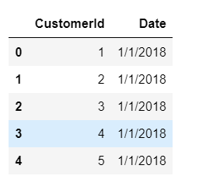
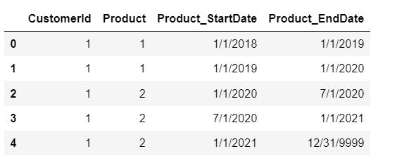
Data Description
Customer Table
Product Table
Checked for nulls, duplicates, outliers
Converted the Date columns into datetime

Slide 4
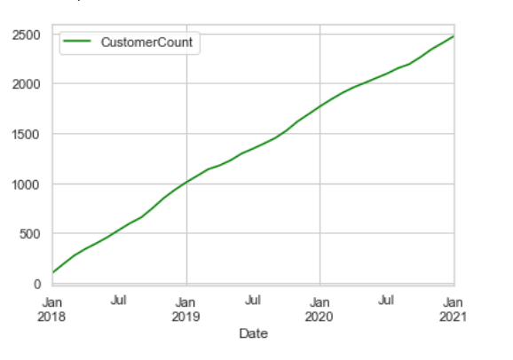
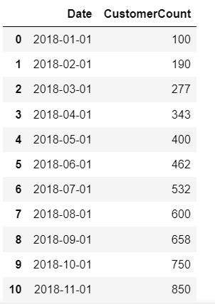

1. Has Gas South’s customer count over time increased or decreased since 2018? How many customers do we have as of January 1st, 2021?

Slide 5
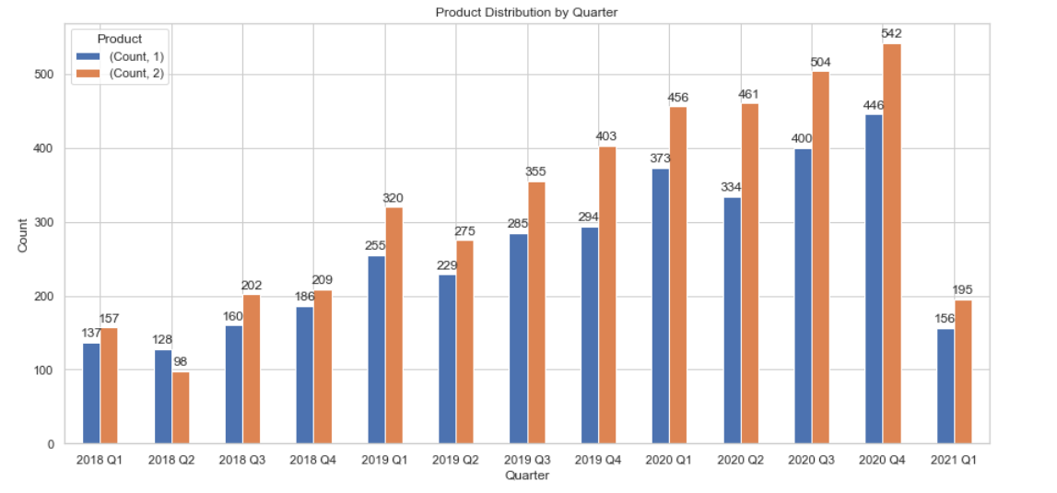
2. How has our customer portfolio mix changed over time? Please show a graph of our customers’ product distribution over time.

Slide 6
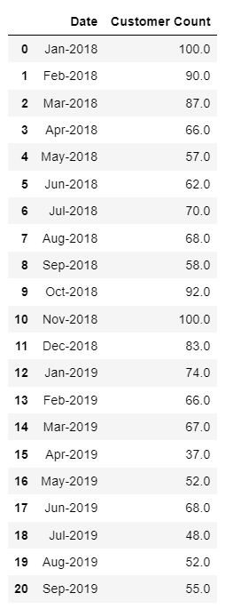
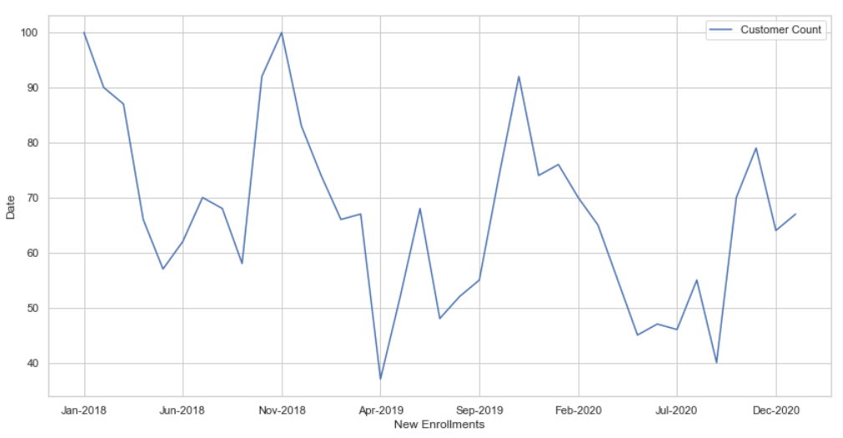
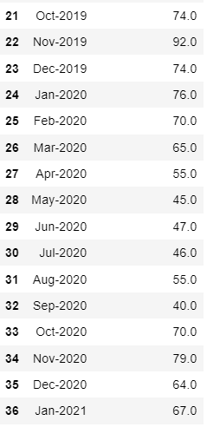
3. How many new customers (enrollments) do we have every month?

Slide 7
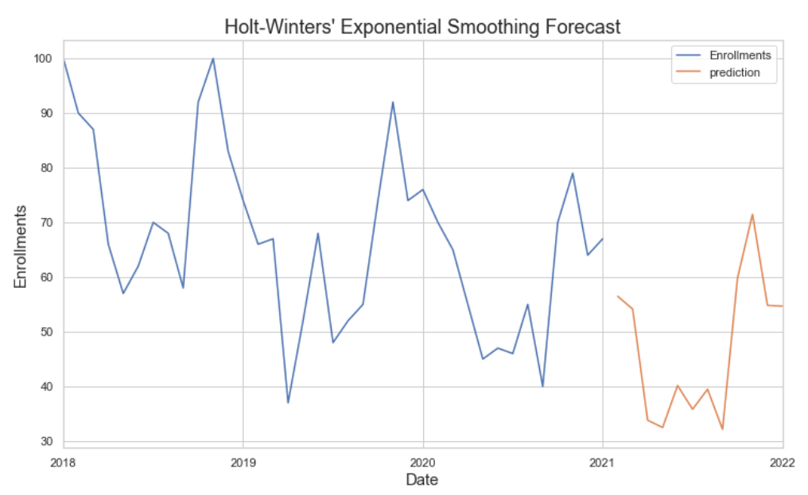
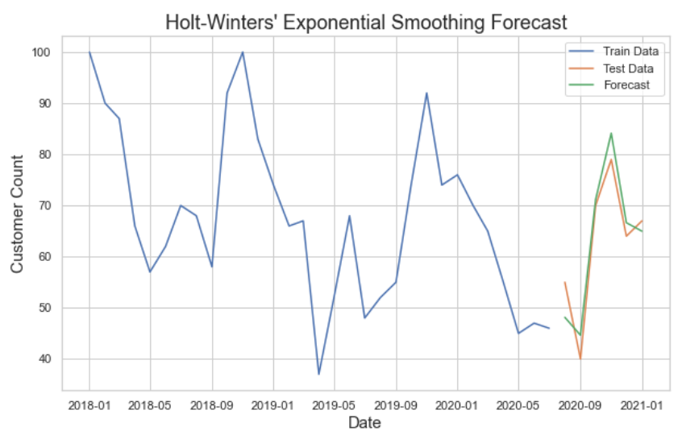
4. Please forecast the number of enrollments that we anticipate for the remainder of 2021. Show the forecast broken out by month and graphically display how this compares with historical numbers. Please explain the methodology (at high level) and why you chose the method for the forecast
RMSE: 4.23
Mean: 62.5
Std: 13.5

Slide 8
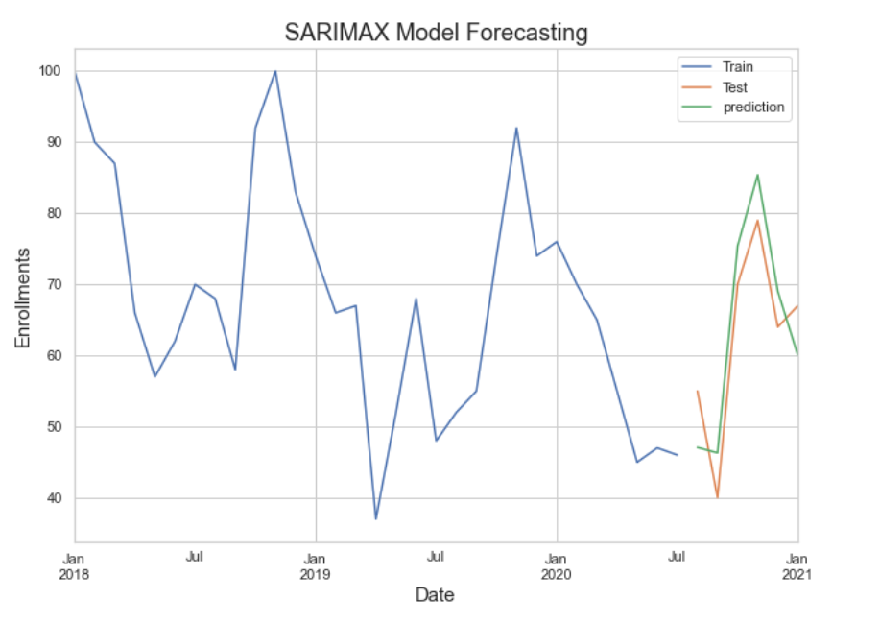
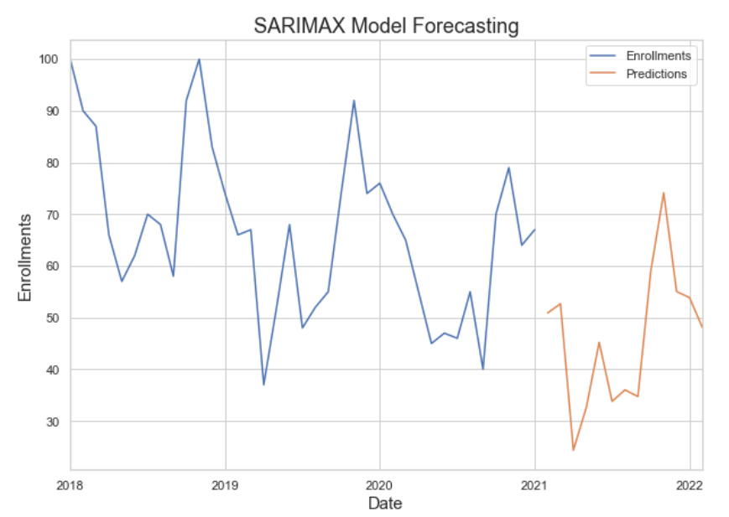
4. Please forecast the number of enrollments that we anticipate for the remainder of 2021. Show the forecast broken out by month and graphically display how this compares with historical numbers. Please explain the methodology (at high level) and why you chose the method for the forecast
RMSE: 6.41
Mean: 62.5
Std: 12.33

Slide 9
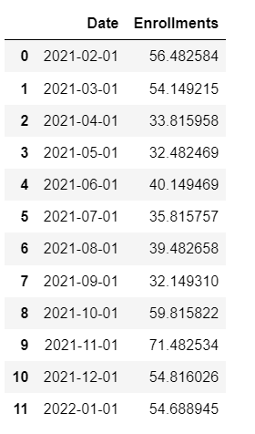
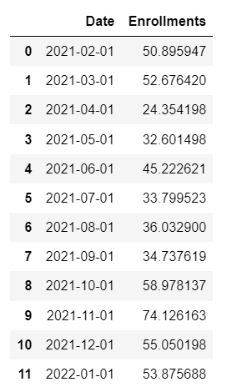
4. Please forecast the number of enrollments that we anticipate for the remainder of 2021. Show the forecast broken out by month and graphically display how this compares with historical numbers. Please explain the methodology (at high level) and why you chose the method for the forecast
HOLT WINTER’S ES
SARIMAX

Slide 10
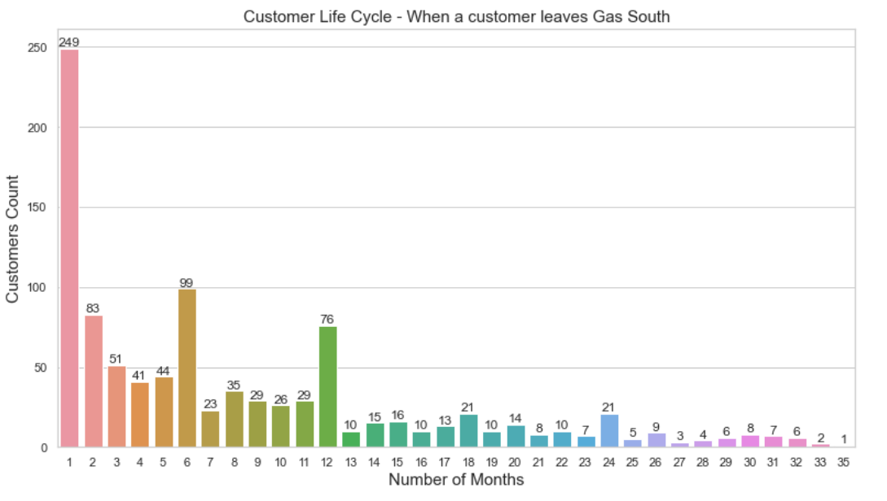
5. Show the distribution of when during a customer’s lifecycle a customer leaves Gas South. (The xaxis should be the number of months the customer was with Gas South).

Slide 11

THANK YOU

